Slide 1

Environmental Awareness & Education
Dr J K Sharma
Professor & Head
Center for Environmental Sciences & Engineering
School of Natural Sciences

Slide 2
Reasons to Learn About the Environment
We are integrally linked with all living things on our planet.
However, recent events show that our day-today existence severely impacts the Biosphere that we share with all other organisms.
The study of Environment promotes the development of problem-solving skills.
There are alternatives to the way we live today. By studying about the Environment we can learn why we need to change, what we need to change, and how we can change so that we can all live in an environmentally sustainable way improving the quality of our lives and of the planet.

Slide 3
Environmental Ethics-Awareness
Environmental ethics is the part of environmental philosophy which considers extending the traditional boundaries of ethics from solely including humans to including the non-human world.
There are many ethical decisions that human beings may have to make with respect to the environment. For example:

Slide 4
Environmental Ethics-Awareness
Should we continue to clear cut forests for the sake of human consumption , hydroelectric dams and other developmental activities?
Should we continue to make diesel powered vehicles when they are so much polluting the atmosphere?
Is it right for humans to knowingly cause the extinction of a species for the convenience of humanity?
Should we clear agriculture lands for urban expansion?
Should we convert wetlands in to agriculture lands?
What environmental obligations do we need to keep for future generations?
Should we continue pollute rivers by immersing idols in large numbers?

Slide 5
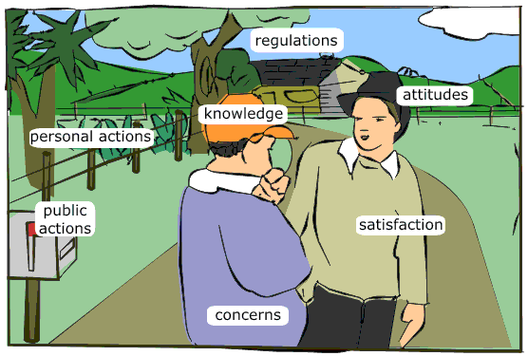
Environmental Awareness
It is extremely important that each individual realize his/her responsibility for preserving the environment, to make it a part of daily life, create the same attitude in their families, and spread it to the community – Environmental Ethics
.
Environmental Awareness is important because it helps to spread environmental education, especially in the non-formal system among different sections of the society.

Slide 6
Environmental Education
A better understanding of our environment is indispensable for its rational management
because ……
it would enable us to comprehend the environment’s resilience to man’s action and the maximum potential it may offer for sustained development of mankind.

Slide 7
ENVIRONMENTAL EDUCATION
· The protection of environment is a matter of national concern to all of us and biodiversity is the most important component of environment that deserves special attention as we are completely dependent on it for our survival.

Slide 8
ENVIRONMENTAL EDUCATION- Biodiversity
Better understanding of biodiversity conservation can only come through environmental education, and this is why environmental education is so important and essential.
· Biodiversity should be part of environmental education in educational curricula.
· Biodiversity should be part of environmental education for all sections of the society.

Slide 9
Environmental Education
There is no precise and universally acceptable definition.
“The basic aim of environmental education is:
To succeed in making individuals and communities understand the complex nature of the natural and the built environments resulting from the interaction of their biological, physical, social, economic and cultural aspects,
To acquire the knowledge, values, attitudes and practical skills to participate in a responsible and effective way in anticipating and solving social problems,
And in the management of the quality of environment”.

Slide 10
WHAT IS ENVIRONMENTAL EDUCATION
By
“Environmental Education” we understand all kind of education and information which aim at creating the correct approach of human being to his/her natural environment in the sense of conservation, wise use and management of natural resources, especially biodiversity.

Slide 11
MAJOR REQUIREMENTS FOR ENVIRONMENTAL EDUCATION
Within the general framework of environmental education, there are several major requirements which are likely to contribute to its success. Six major factors are:
1. Inter-disciplinarity
2. Interrelated disciplines/ case studies/virtual examples
3. Flexibility
4. Non-dogmatic
5. Emphasis on problem solving
6. Practice what you preach – use of plastic bags/bottles
7. Environmental Ethics

Slide 12
ENVIRONMENTAL EDUCATION
Who to be involved:
- School children
- College/University students
- Legislators and Administrators
- Professional Bodies and special interest groups
- Communities affected by developmental projects
NGOs
Corporate bodies as part of Corporate Social
responsibilities (CSR)

Slide 13
Environmental Education in Curriculum
• To be effective environmental education should be both through formal curricula in schools and colleges/universities and through continuing education with the assistance of mass media.
There is vital need for suitable books, brochures, pamphlets, video films to support many kinds and levels of environmental education related to biodiversity that is necessary for ensuring an effective and enlightened handling of biodiversity related problems, especially conservation aspects.

Slide 14
ENVIRONMENTAL EDUCATION
Language: Local language to be used
Objectives:Well defined objectives addressing a specific problem of the area/region.
Methods:
i. School/college curricula
ii. Charts, posters, dumb shows
iii. Talks, drama
iv. Quiz competitions
v. Essay writing
vi. Video film shows
vii. Exhibitions
Pilot studies
Field Excursions/field visit - Assignments/Report
writing

Slide 15
ENVIRONMENTAL EDUCATION
Pilots studies – real life situations dealing with plants, animals, pollution and microorganisms.
A few examples:
i. Diversion of paddy fields for construction or other purposes adversely affect the aquatic biodiversity and ecosystem.
ii Removal of natural flora/forest and replaced by monoculture plantations can benefit industries and not local people.
iii. Diversion of agricultural lands for urban expansion adversely affects cultivated and wild biodiversity.

Slide 16
ENVIRONMENTAL EDUCATION
iv. Damage caused by rats, monkeys and other wild animals in agricultural crops – gregarious flowering of bamboos in NE.
v. Grazing by cattle/goats adversely affects the natural ecosystem.
vi. Use of excessive pesticides on biodiversity – flora and fauna.
vii. Effect of environmental pollution on plant health – physiological parameters.

Slide 17
ENVIRONMENTAL EDUCATION
viii. Mushroom flora of an area – identifying useful/edible and poisonous mushrooms in disturbed and undisturbed forest ecosystem.
ix. Waste generated in your locality and its disposal
x. Water pollution in irrigation water canals
xi. Plants of your locality and identification of medicinal plants and their uses.
xii. Effect of Dust pollution on agriculture plants and their productivity
xiii. Organizing fares/melas of agricultural biodiversity (through seeds) of a region

Slide 18
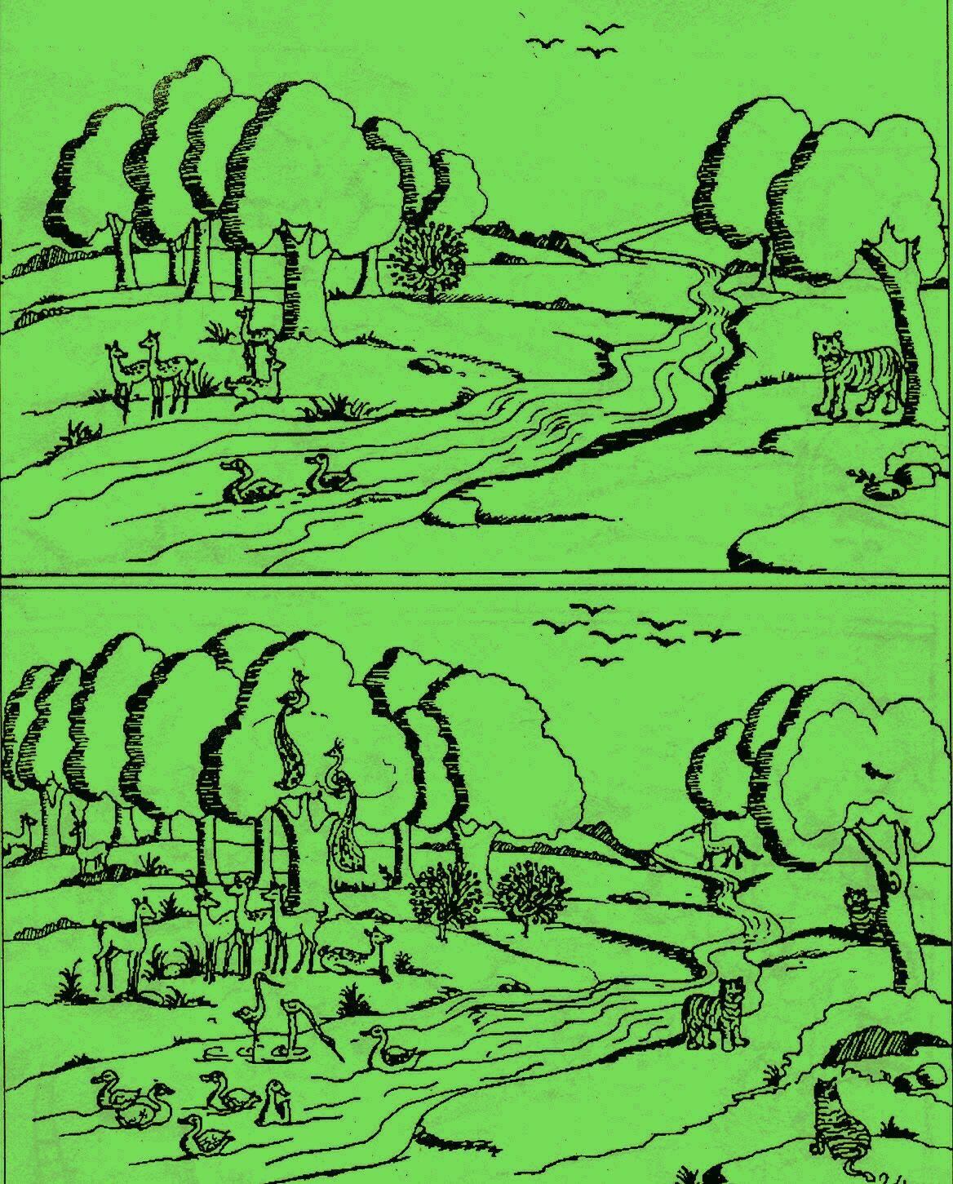
Biodiversity and Environmental Education
A few illustrated examples
of pilot studies with
reference to forests
Biodiversity of an ecosystem is related to its species richness.
Large number of species in an area is an indication of stable ecosystem.

Slide 19
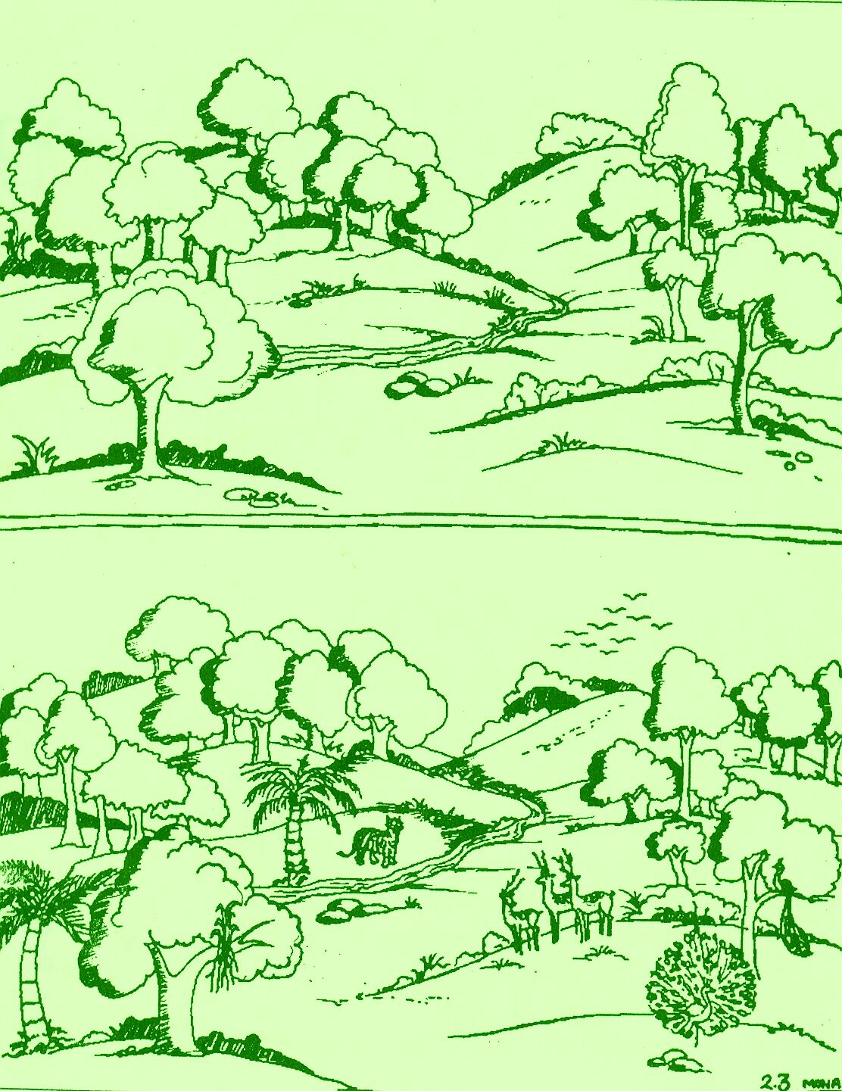
Uncontrolled human activities, felling of trees, poaching of animals result in the loss of habitat for many plants and animals and consequently loss of biodiversity.

Slide 20
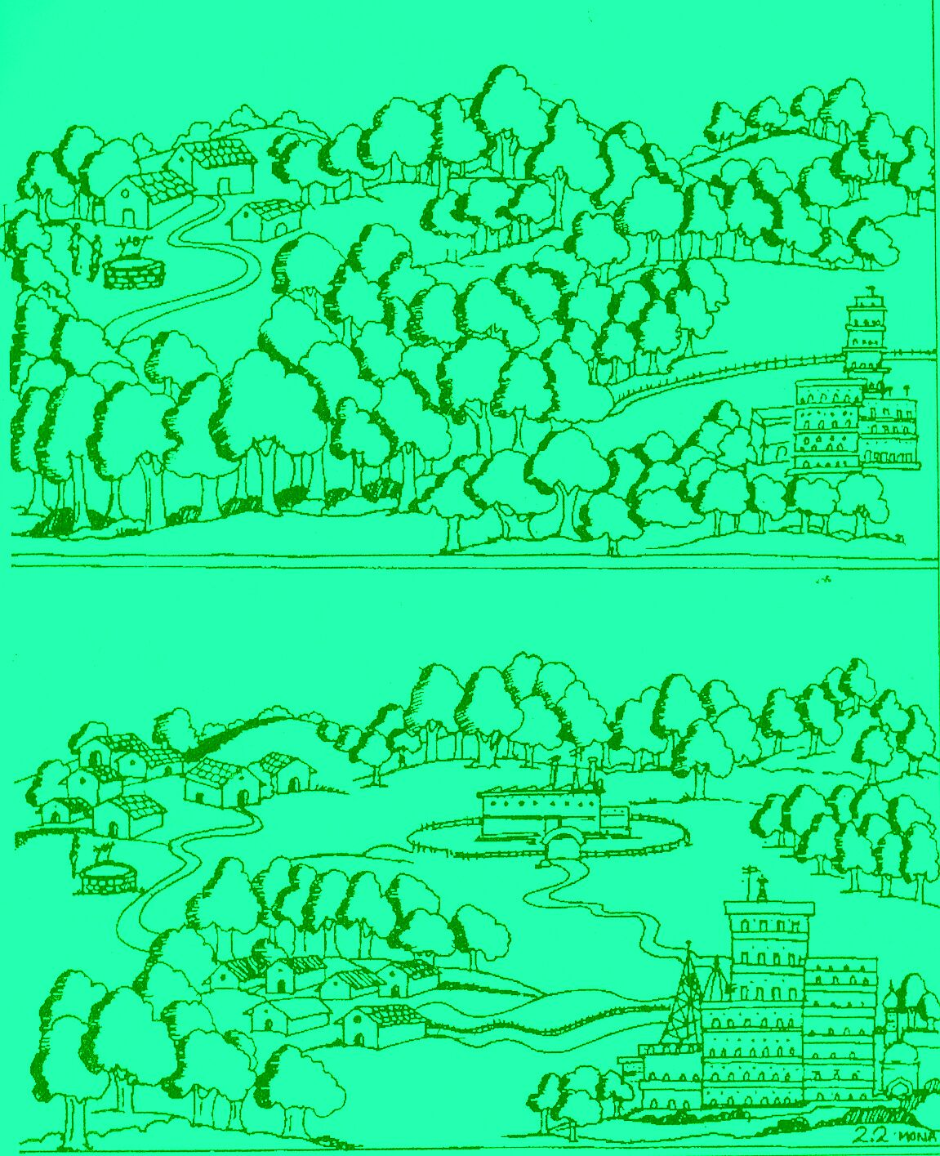
Fragmented ecosystem due to developmental activities substantially affect the biodiversity, especially wildlife.

Slide 21
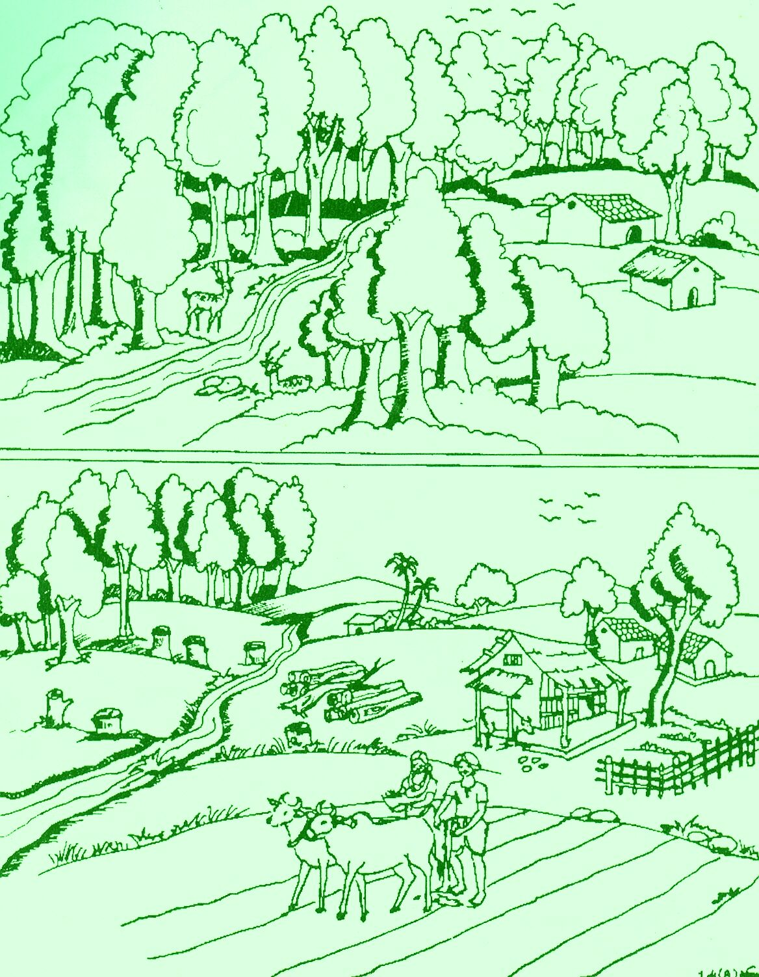
Forest area diverted to agriculture or other developmental activities reduces the forest cover, adversely affects the biodiversity and the overall ecosystem.

Slide 22
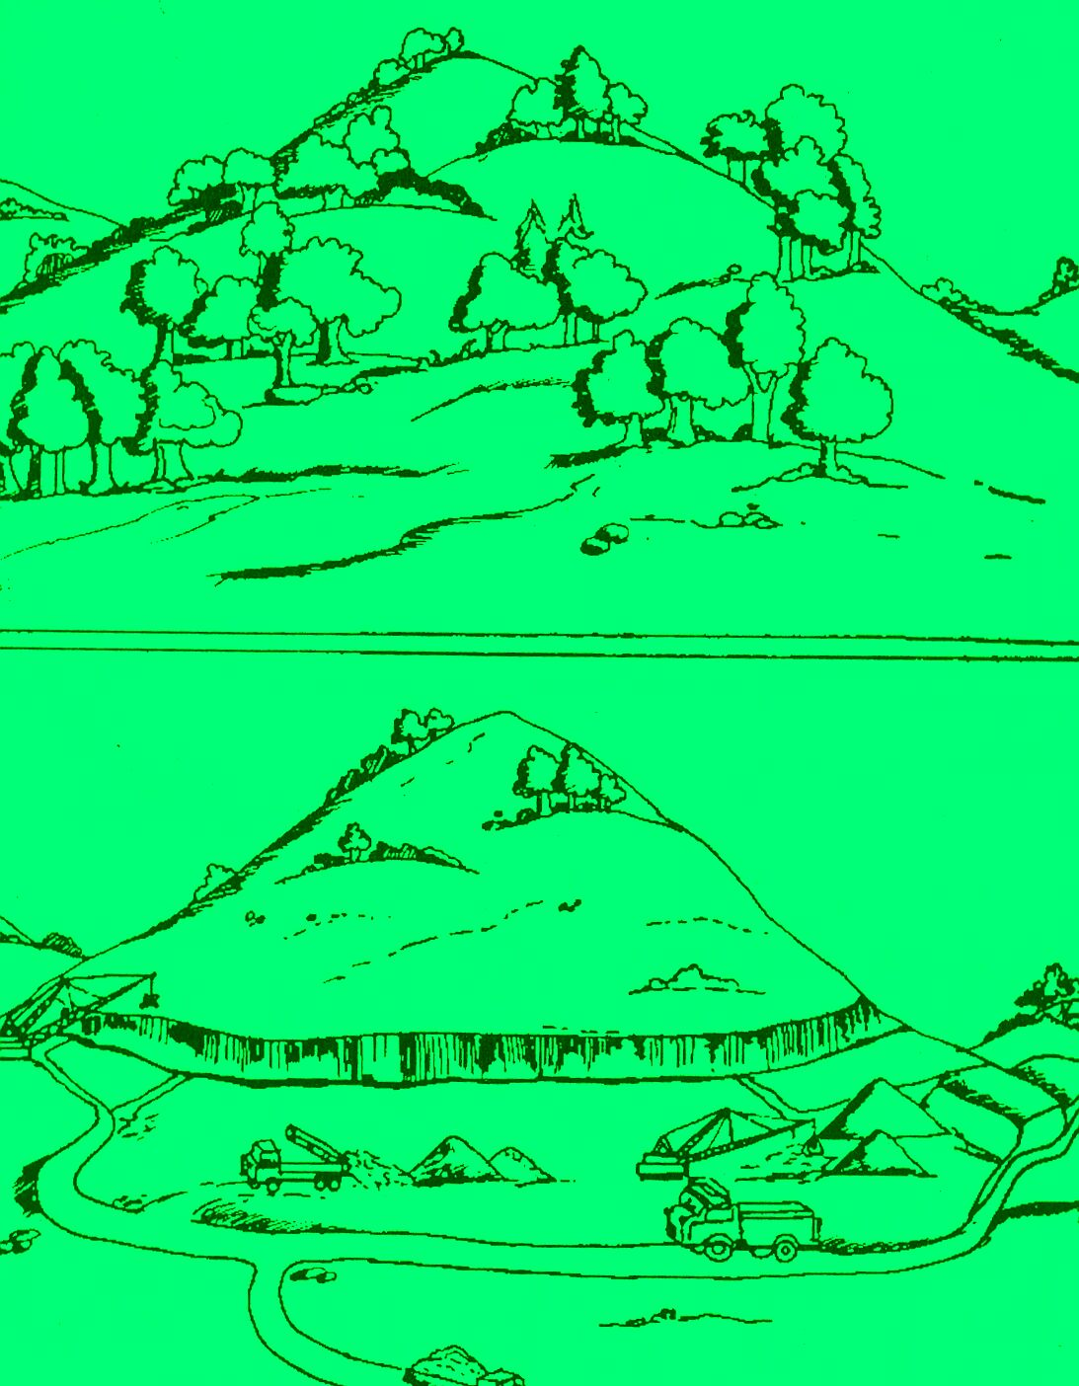
Forest area diverted for mining adversely affects the biodiversity, deplete forest soil and pollute the environment due to mined waste.

Slide 23
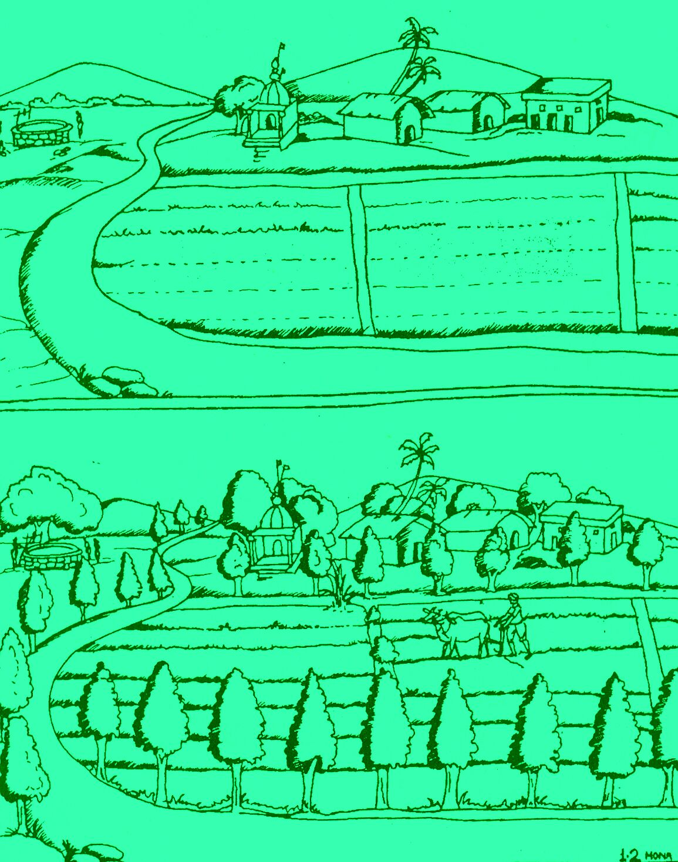
How trees outside the forest area are beneficial to people and environment.

Slide 24
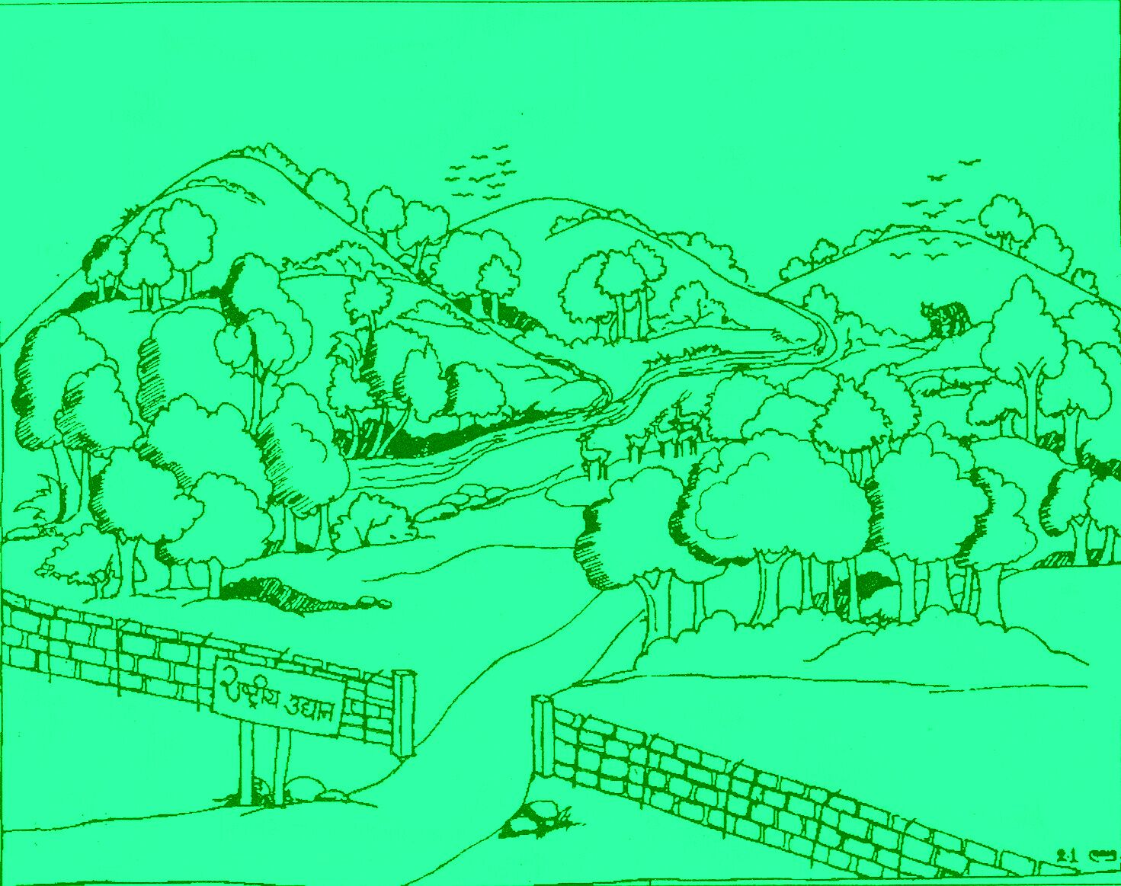
If the area of protected ecosystem is left undisturbed, the biological diversity is thereby conserved, which leads to sustainable forest management.

Slide 25
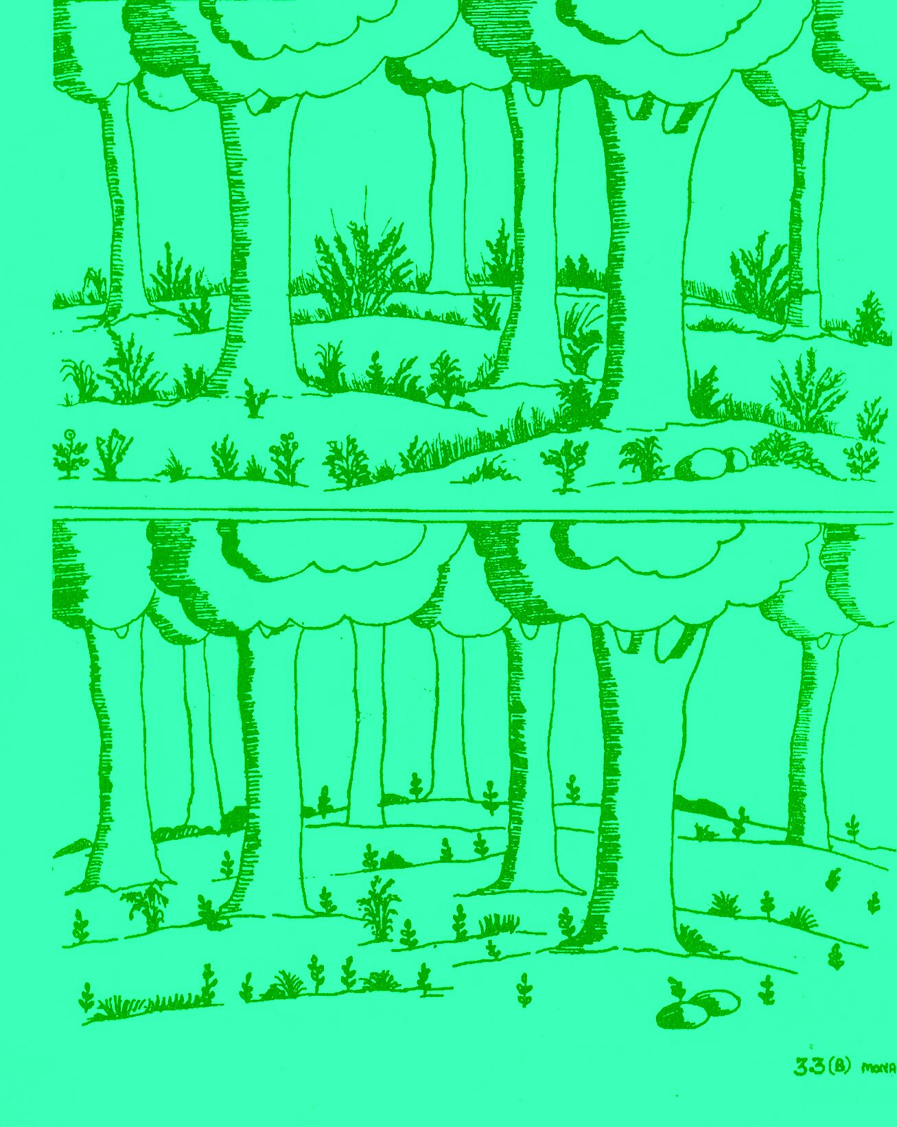
Invasion of weeds in natural ecosystem results in depletion of biodiversity.

Slide 26
Uncontrolled human activities, felling of trees, poaching of animals result in the loss of habitat for many plants and animals and consequently loss of biodiversity.

Slide 27
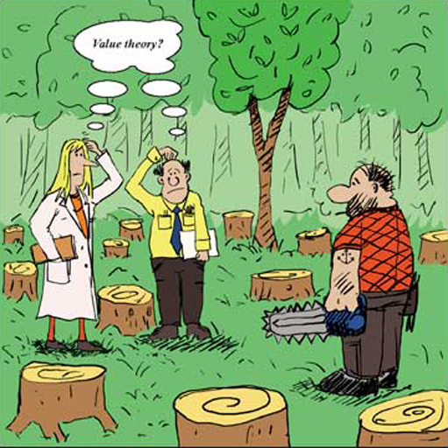

Slide 28
REFERENCES ON PRESENT STATUS OF ENVIRONMENTAL EDUCATION IN INDIA
M Pandya ‎2005. Environmental Education- What and Why? by
Somenath Halder 2012. An appraisal of environmental education in higher school education system: A case study of North Bengal, India International Journal Of Environmental Sciences Volume 2, No 4, 2012
G.V.Gopal and V.V. Anand. Environmental Education in school Curriculum an overall perspective. Regional institute of education, Mysore-6.
Status of Environment Education at School Level in Delhi 2013. http://delhigreens.com/2013/06/12/status-of-environmental-education-at-school-level-in-delhi/#sthash.7b7LIzxF.dpuf
Nath, B. Environmental education and awareness. Environmental Education And Awareness.Vol. 1
Shilpa Shet. Environmental education finally finds a place in India's school textbooks.Infochange Education
C.J. Sonowal 2009. Environmental Education in Schools: The Indian Scenario.
J. Hum Ecol, 28(1): 15-36 (2009)

Slide 29

Thanks…

